Slide 1
C Programming
Floating Point Inaccuracy
Copyright 2012 Carlo Sgro

Slide 2
Don’t use float or double
in most equality
comparisons

Slide 3
float f1 = 34.45;
float f2 = 0.05;
float f3 = 34.5;
printf("%f %f %f\n", f1, f2, f3);
printf("%f\n", f1 + f2);
if( f1 + f2 == f3 )
{
printf("They're equal\n");
}
else
{
printf("They're not equal\n");
}
Copyright 2012 Carlo Sgro

Slide 4
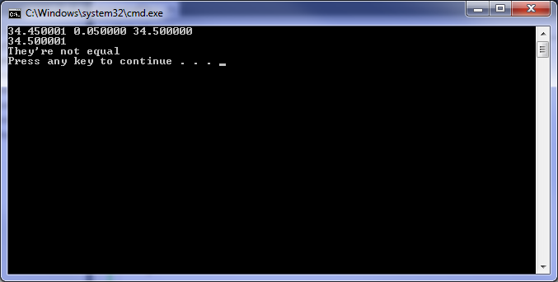

Slide 5
Let’s try it again with double

Slide 6
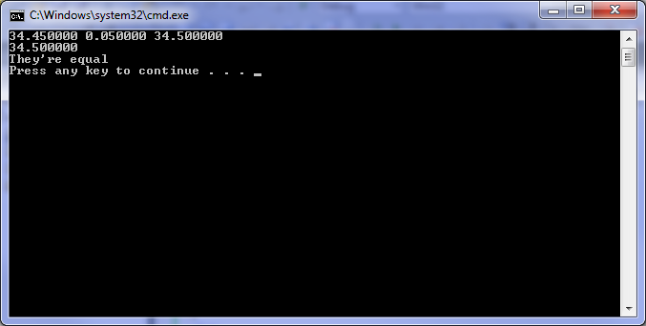
It works!

Slide 7
Then why not use
double all the time then?

Slide 8
This only decreases
the chances of
the problem
happening

Slide 9
And it takes
more memory

Slide 10
Change the values a bit ...
double f1 = 34.4512345;
double f2 = 0.05;
double f3 = 34.5012345;

Slide 11


Slide 12
Floating point numbers
are very often inaccurately
represented

Slide 13
Don’t count on equality comparisons

Slide 14
A better way ...
Allow for a
small margin-of-error

Slide 15
int AlmostEqualDoubles(double nVal1, double nVal2, double nEpsilon)
{
if( (((nVal2 - nEpsilon) < nVal1) && (nVal1 < (nVal2 + nEpsilon))) == 0 )
{
return 0;
}
else
{
return 1;
}
}
// by John Simmons at http://www.codeproject.com/Articles/16646/Reliable-Floating-Point-Equality-Comparison
// licenced under CPOL 1.02 (http://www.codeproject.com/info/cpol10.aspx)
// function name changed from AlmostEqualDoubles2 to AlmostEqualDoubles for these slides
// code changed to avoid the use of the bool datatype, which is present in C++ but not C

Slide 16
Call using:
if( AlmostEqualDoubles(f1 + f2, f3, 0.001) == 0 )

